Slide 1
NutriMind The Smartest Nutritionist
CAPSTONE PROJECT
Student Name : Garv kanojia
College Name : Maharaja Surajmal Institute of Technology
Department : Bachelor of Technology
Computer Science and Engineering

Slide 2
OUTLINE
Problem Statement
Technology used
Wow factor
End users
Result
Conclusion
Future scope
IBM Certifications
Git-hub Link

Slide 3
Problem Statement
In an era where health awareness is growing, individuals increasingly seek personalized nutrition guidance. However, most existing tools provide generic diet plans, lack real-time adaptability, and fail to consider a person's holistic lifestyle, cultural preferences, allergies, and evolving health conditions. Furthermore, dieticians and nutritionists face limitations in scaling personalized consultations due to time and resource constraints. Generative AI presents a groundbreaking opportunity to revolutionize this space by enabling an intelligent, interactive, and adaptive virtual nutrition assistant. By leveraging natural language processing (NLP), multimodal understanding, and large-scale dietary databases, an AI-powered assistant can generate dynamic meal plans, recommend smart food swaps, and explain nutritional choices—all tailored to the individual.
Proposed Solution:
An intelligent AI Nutrition Assistant, "NutriMind," that leverages a state-of-the-art Large Language Model to function as an interactive and adaptive virtual nutrition expert. It will generate dynamic meal plans, offer smart food swaps, and provide clear, science-backed explanations tailored to each individual's unique health profile and goals.

Slide 4
Technology used
IBM cloud lite services
Natural Language Processing (NLP)
Retrieval Augmented Generation (RAG)
IBM Granite model

Slide 5
IBM Cloud Services used
IBM Cloud Watsonx AI Studio
IBM Cloud Watsonx AI runtime
IBM Cloud Agent Lab
IBM Granite foundation model

Slide 6
IBM cloud services used
Wow Factors
This agent bridges the gap between generic diet apps and expensive human consultations, offering a scalable and deeply personalized solution.
Unique Features:
Deep Personalization: Creates meal plans based on a comprehensive profile including goals, medical conditions, activity level, allergies, and cultural food preferences.
Interactive & Adaptive: Continuously learns from user feedback to refine and adjust recommendations in real-time (e.g., modifying plans if a user feels hungry or bloated).
Contextual Explanations: Doesn't just tell you what to eat, but explains why a food is beneficial for your specific goals, enhancing user knowledge and adherence.
Built-in Safety Guardrails: Includes a mandatory medical disclaimer and is programmed to refuse to diagnose conditions or provide dangerously unhealthy advice, prioritizing user safety.
On-Demand Smart Swaps: Instantly provides nutritionally equivalent alternatives for any food item, making the plan flexible and practical for daily life.

Slide 7
End Users
Health-Conscious Individuals: Anyone seeking to improve their diet, lose weight, build muscle, or enhance their overall well-being with a data-driven approach.
Individuals with Specific Dietary Needs: Users managing conditions like Type 2 Diabetes, hypertension, or food allergies (e.g., soy, gluten) who require carefully tailored meal plans.
Fitness Enthusiasts: Athletes and gym-goers looking to optimize their nutrition for performance, recovery, and specific fitness goals.
Busy Professionals: People who need a quick, reliable, and convenient way to plan healthy meals without extensive research.

Slide 8
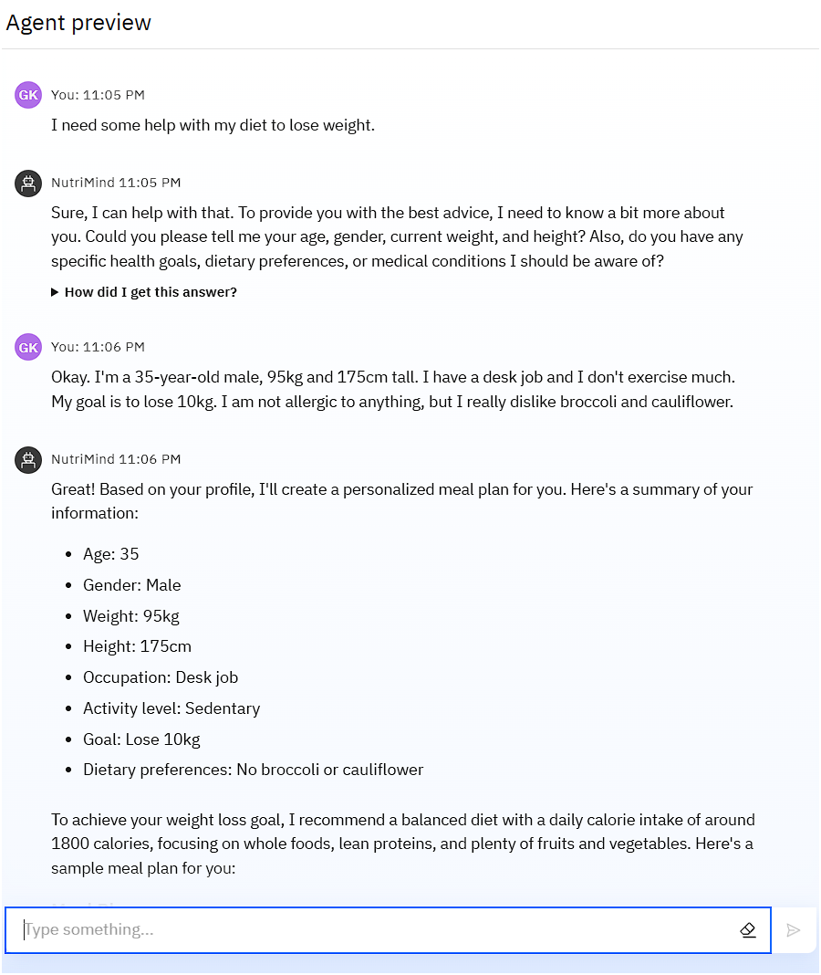
Results

Slide 9
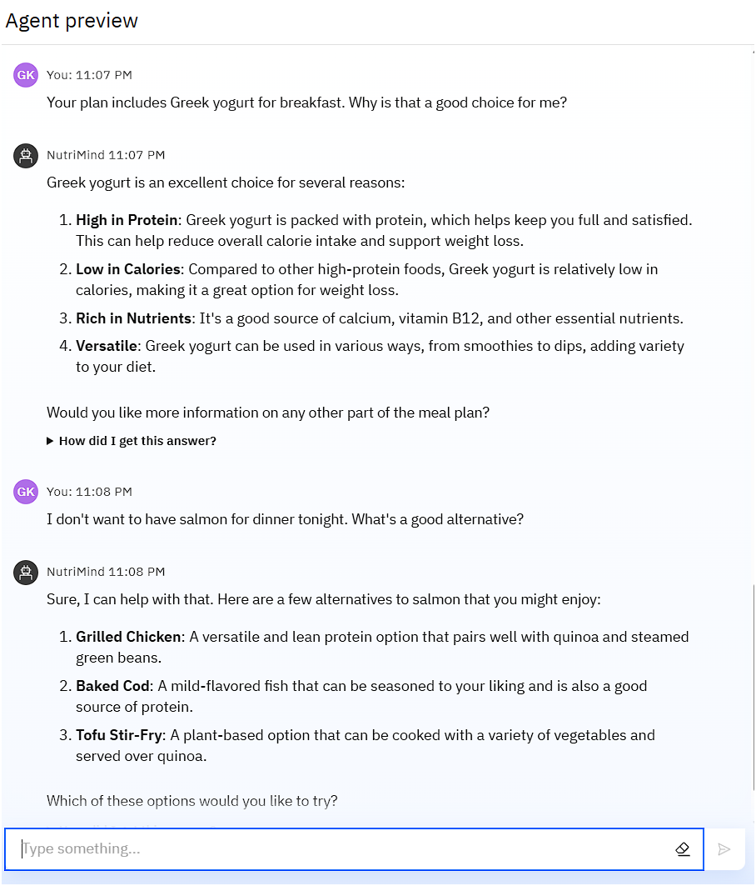
Results

Slide 10
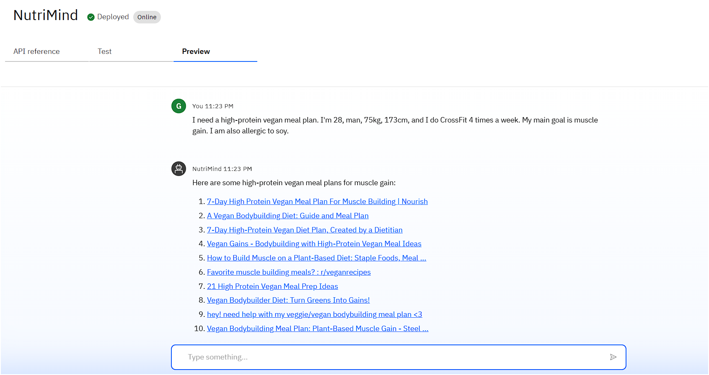
Results
Deployed AI Agent

Slide 11
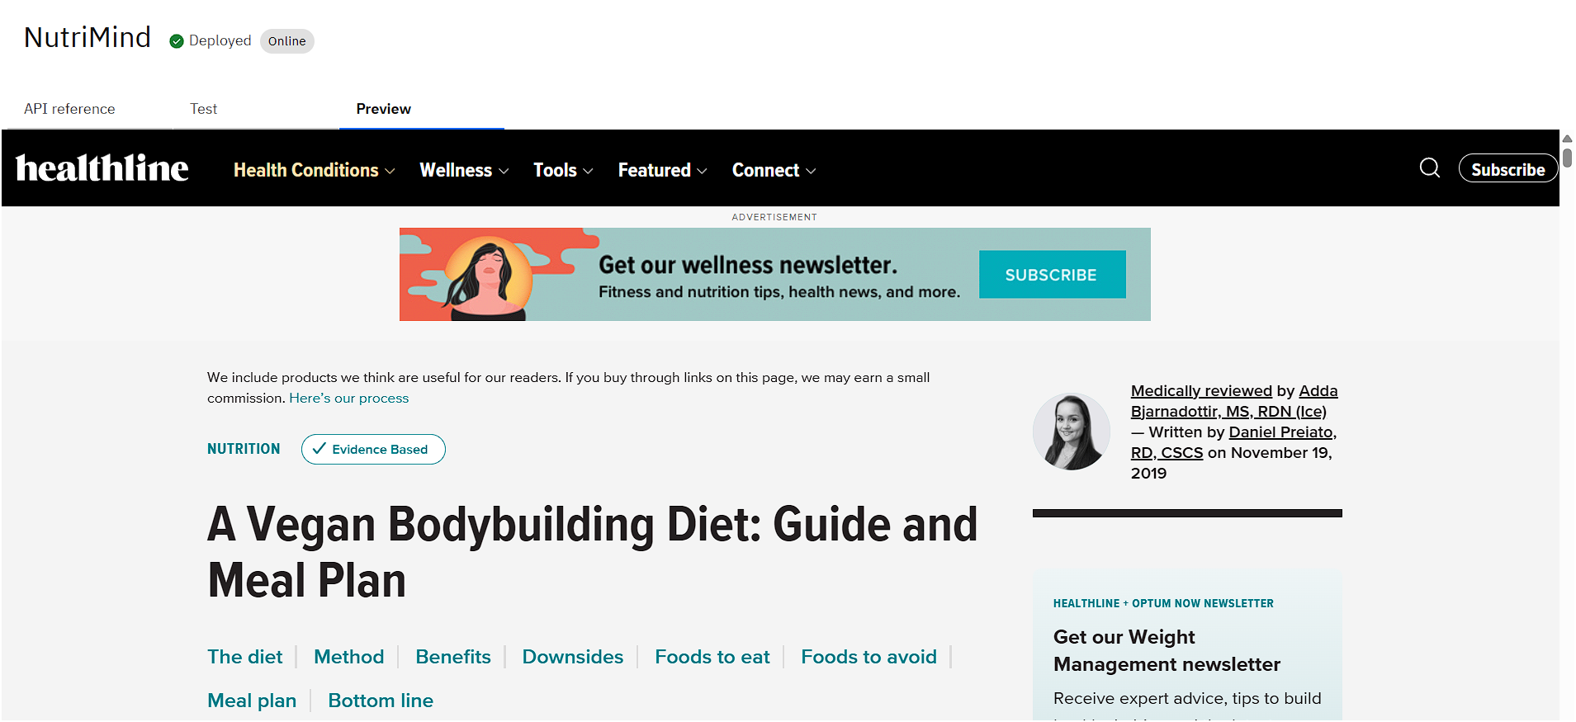
Results
Deployed AI Agent

Slide 12
Conclusion
NutriMind successfully acts as a knowledgeable, safe, and personalized AI Nutrition Assistant.
It effectively uses its instructions and integrated search tools to create scientifically-grounded and highly relevant meal plans.
By explaining the "why" behind its recommendations and adapting to feedback, the agent empowers users to build healthier, sustainable eating habits.
NutriMind demonstrates how Generative AI can make personalized health guidance accessible, affordable, and scalable.

Slide 13
Future scope
Multimodal Inputs: Integrate capabilities to analyze food photos from users or read nutrition labels from images.
Grocery List & Recipe Generation: Automatically generate a weekly grocery list based on the meal plan and provide full recipes for suggested meals.
Integration with Wearables: Connect with fitness trackers (e.g., Fitbit, Apple Watch) to automatically sync activity levels and adjust calorie recommendations.
Progress Tracking & Visualization: Allow users to log their progress and visualize their journey over time with charts and graphs.
Multilingual Support: Expand the agent's capabilities to offer nutritional guidance in multiple languages.

Slide 14
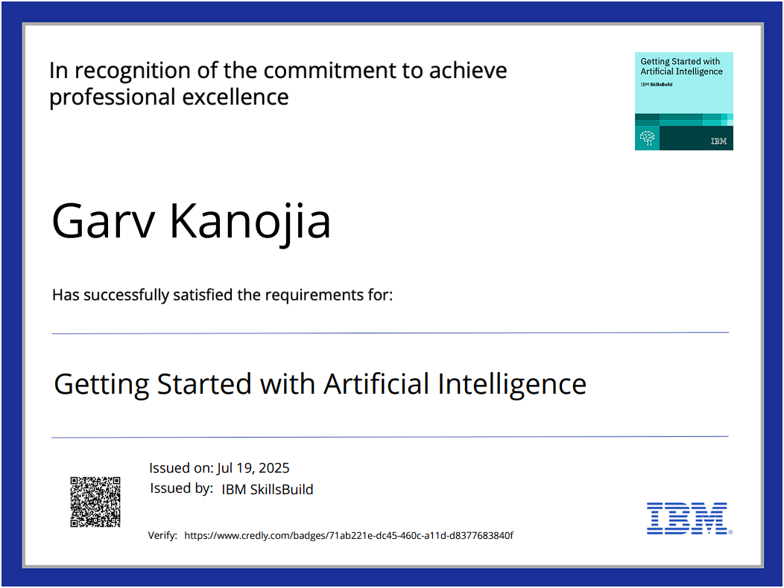
IBM Certifications

Slide 15
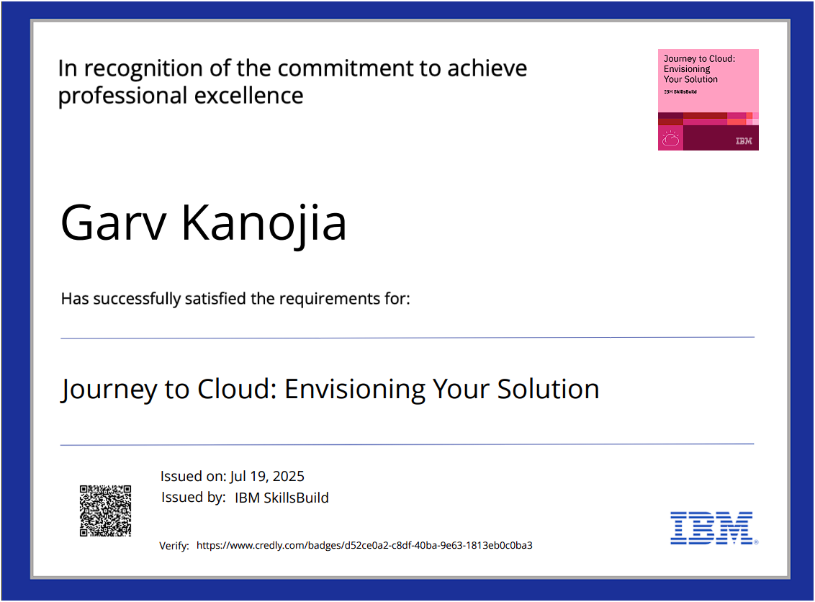
IBM Certifications

Slide 16
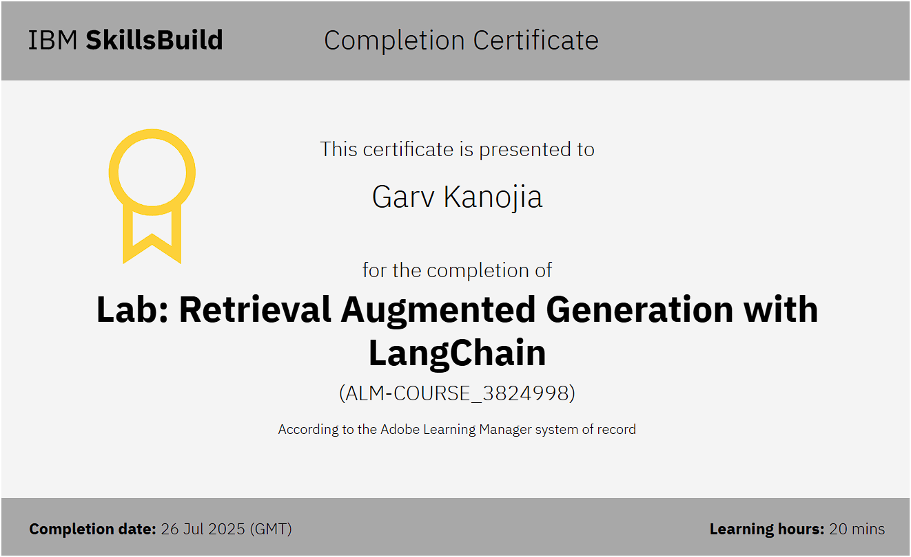
IBM Certifications

Slide 17
Github Link
Github link : https://github.com/Garv-Kanojia/NutriMind

Slide 18
THANK YOU

